Slide 1
Nigeria Food Price Predictions Feature Engineering Steps
After the EDA (Exploratory Data Analysis) , there were significant evidence that there were some feature which has no relation with the dependent feature , Few of them , I have dropped during the EDA itself. ( Currency columns)
During the Feature Engineering , First I have dropped [“USD PRICE “ and “Price Flag”)
There were State , Longitude and Latitude columns in the , By understanding it is clean that longitude and latitude has one to one relation with the state columns eventually I analyze these feature and I has concrete information to established the conclusion that there are one to one relation b/w State longitude and latitude hence , I have dropped the columns of longitude and latitude .

Slide 2
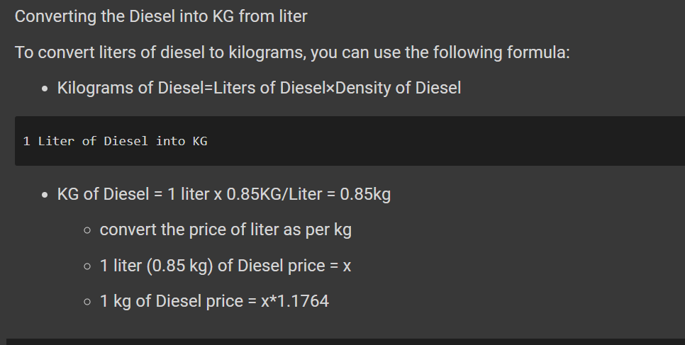
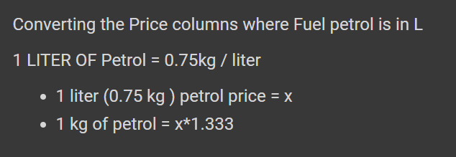
Nigeria Food Price Predictions Feature Engineering Steps
Then , I analyse the Unit columns of the data . I observed that all the units are in 1KG expect fuel , Bread , YAM . Whatever the unit was in “L” I have converted into 1KG by applying the Density/Liter formula with respective fuels.

Slide 3
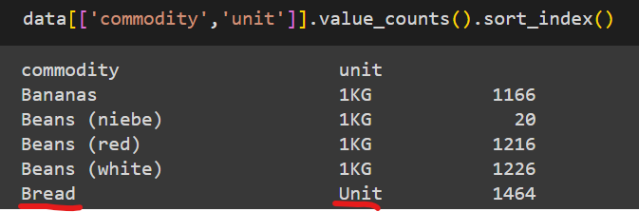
Fuel Commodity , I have converted the Unit into 1KG by applying the density /liter formula and change the price equivalent to 1KG.
BREAD commodity Unit was in “UNIT” which I left as it is by considering the unit equivalent to 1KG , thus whatever the price Model will predict for UNIT Bread ( 1 packet) by default.
Similarly , Unit of YAM are in 100 Tubers , I left unchanged thus whatever the price will get predicted by the model will be for 100 Tubers by default and same for EGGS which unit are in 30 pcs .
I have dropped one of the entry of OIL(Palm ) with unit “L”, because Oil (Palm) has two Unit , 1KG and “L” .

Slide 4
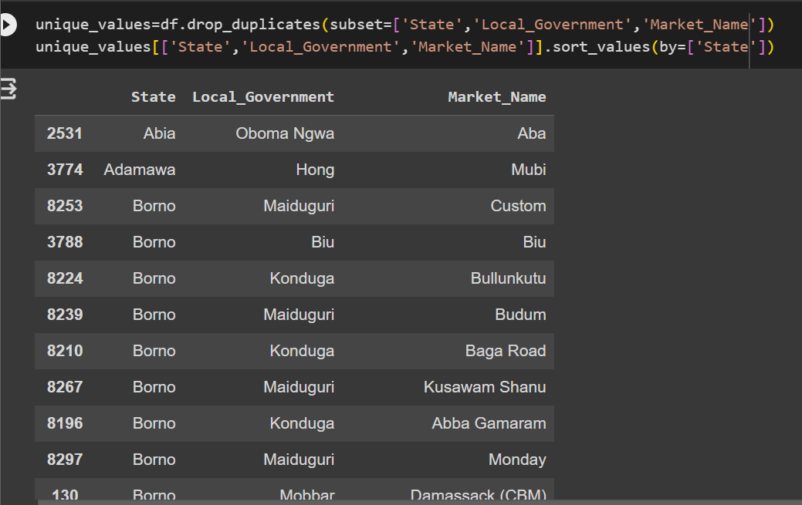
Next , I analyse the State, Local Government and Market _Name columns and significantly found that there are one to one relation between Local Government and Market_Name hence I drop the “Market_Name”feature .

Slide 5
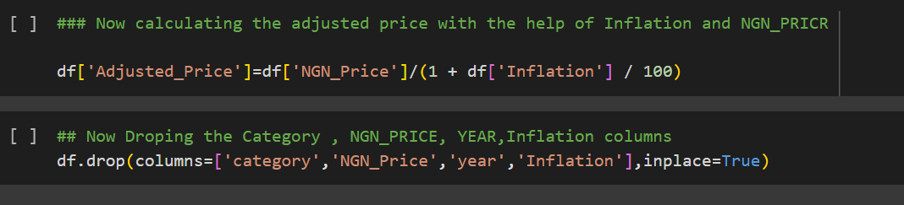
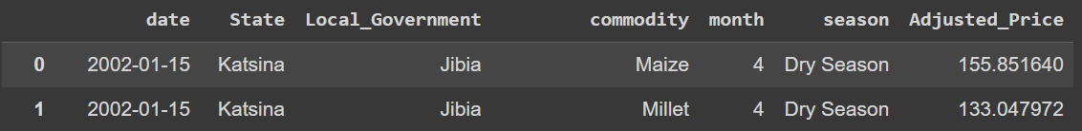
I used the NGN_Price and Inflation feature to calculate the adjusted price and later I drop the Price, inflation and Category from the data.
After dropping all the columns , I left with below shown columns and I used label encoded and one-hot encoder to convert the categorical data into numerical data.

Slide 6
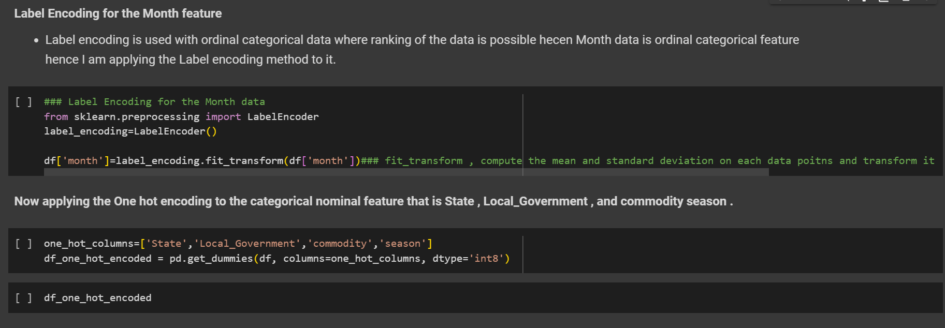
I used Label encoder for categorical ordinal feature such as Month columns and One-hot encoding for the Other feature.

Slide 7
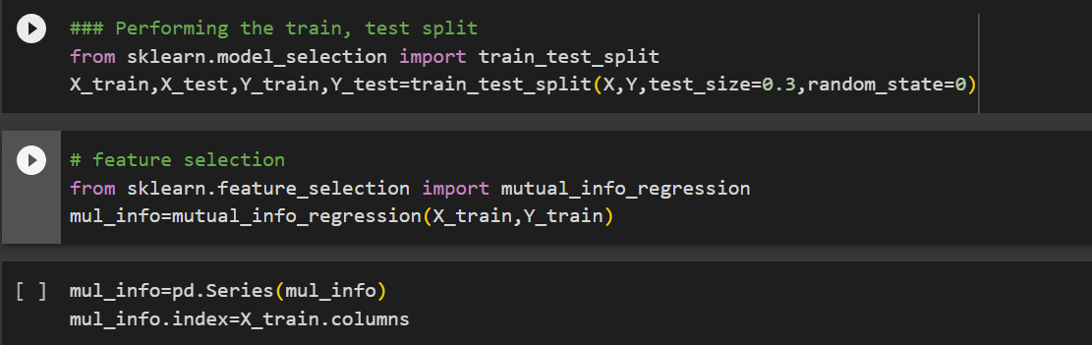
One all the categorical feature are encoded , I used Information Gain to check the feature weightage .
I import the mutual_info_regression using sklearn module

Slide 8
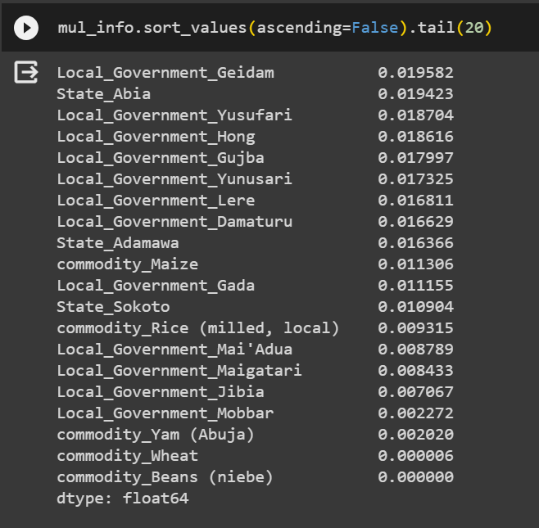
From information gain analysis , I have observed there are few feature there weightage are very negligible.

Slide 9
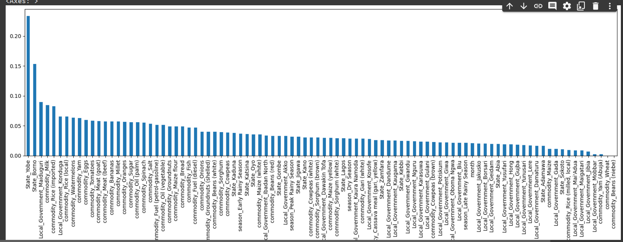
I also visualize the feature with its weightage to have clear understanding .

Slide 10
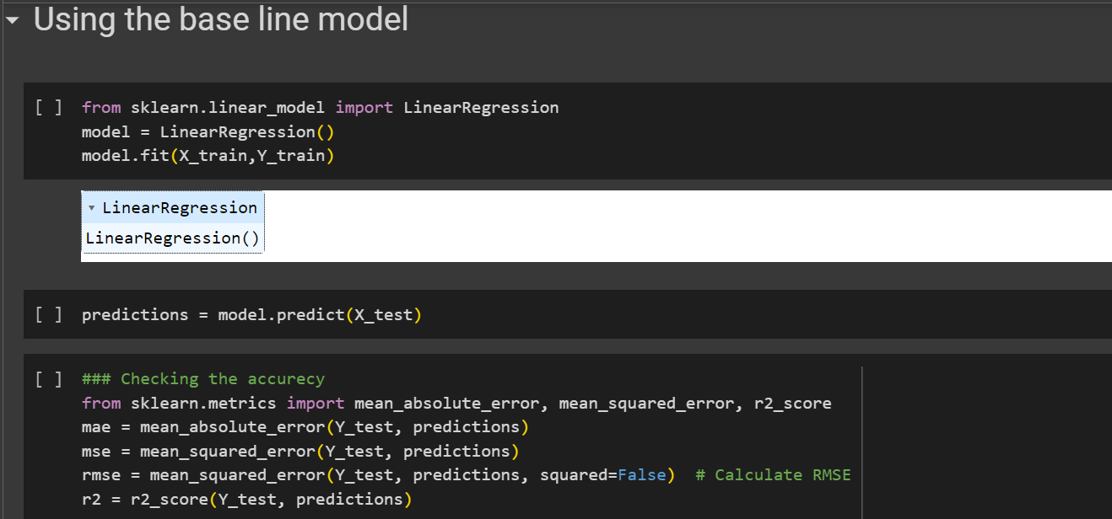
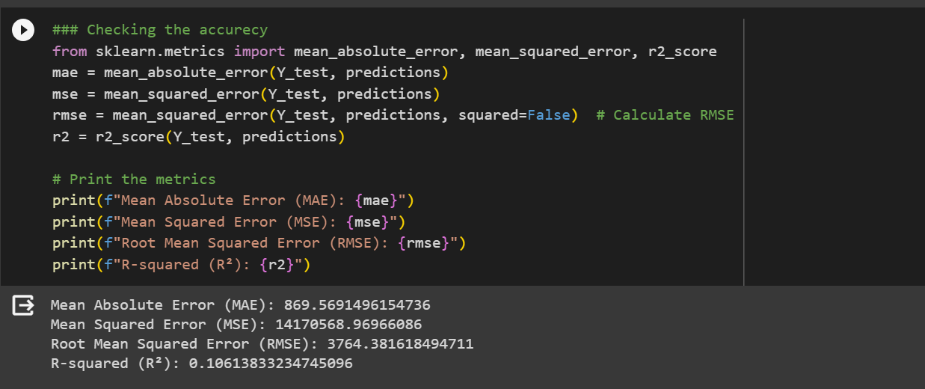
I also develop the base model based on regression to check the accuracy of the model with data.

